Slide 1
SP in Linux

Slide 2
Introduction and essential concepts of LINUX system programming.
APIs and ABIs, standards.
Linux programming.
Program segments/sections, The ELF Format.
Linking and loading; Linux dynamic libraries(shared objects).
Multitasking and paging.
Address translation;
Memory Protection
Comparison with Windows.
-‘Linux System Programming’, Robert Love, O’Reilly

Slide 3
Operating System
Basic Set of programs
Most important is kernel, loaded into RAM when system boots and contains many critical procedures that are needed for system to operate.
Other programs are less crucial.

Slide 4
Objectives
1. Interact with hardware components, servicing, all low level programmable elements included in h/w platform.
2. Provide an execution environment to applications that run on computer system.

Slide 5
System software lives at a low level, interfacing directly with the kernel and core system libraries.
System software includes shell and text editor, compiler and debugger
These components are entirely system software, based on the kernel and the C library

Slide 6
Three cornerstones to system programming in Linux:
system calls,
C library, and
C compiler

Slide 7
System calls
Function invocations made from user space—into the kernel (the core internals of the system) in order to request some service or resource from the operating system.
For reasons of security and reliability, user-space applications must not be allowed to directly execute kernel code or manipulate kernel data.
Instead, the kernel must provide a mechanism by which a user-space application can "signal" the kernel that it wishes to invoke a system call.
The application can then trap into the kernel through this well-defined mechanism, and execute only code that the kernel allows it to execute.

Slide 8
C Library
C library (libc) is at the heart of Unix applications. Even when you're programming in another language, the C library is most likely in play, wrapped by the higher-level libraries, providing core services, and facilitating system call invocation. On modern Linux systems
C library is provided by GNU libc, abbreviated glibc

Slide 9
C Compiler
standard C compiler is provided by the GNU Compiler Collection (gcc).
gcc is also the binary used to invoke the C compiler
Over time, support was added for more and more languages
compiler used in a Linux included—is highly relevant to system programming, as the compiler helps implement the C standard and the system ABI

Slide 10
APIs and ABIs
At the system level, there are two separate sets of definitions and descriptions that impact portability.
One is the application programming interface (API), and the other is the application binary interface (ABI).
Both define and describe the interfaces between different pieces of computer software.

Slide 11
APIs
API defines the interfaces by which one piece of software communicates with another at the source level.
It provides abstraction by providing a standard set of interfaces—usually functions—that one piece of software can invoke from another piece of software(API might abstract the concept of drawing text on the screen through a family of functions that provide everything needed to draw the text)
API defined by the C standard and implemented by the standard C library. This API defines a family of basic and essential functions(string-manipulation routines)

Slide 12
ABIs
API defines a source interface, an ABI defines the low-level binary interface between two or more pieces of software on a particular architecture
It defines how an application interacts with itself, how an application interacts with the kernel, and how an application interacts with libraries.
An ABI ensures binary compatibility, guaranteeing that a piece of object code will function on any system with the same ABI, without requiring recompilation.

Slide 13
ABIs are concerned with issues such as
- calling conventions (The calling convention, for example, defines how functions are invoked, how arguments are passed to functions, which registers are preserved and which are mangled, and how the caller retrieves the return value.)
-byte ordering
register use
system call invocation
Linking
library behavior
and the binary object format

Slide 14
The ABI is intimately tied to the architecture; the vast majority of an ABI speaks of machine-specific concepts, such as particular registers or assembly instructions.
Thus, each machine architecture has its own ABI on Linux.
In fact, we tend to call a particular ABI by its machine name, such as alpha, or x86-64.

Slide 15
Standards
Linux aims toward compliance with two of the most important and prevalent standards: POSIX(Portable Operating System Interface) and the SUS (Single UNIX Specification).
It provides the interfaces documented in SUSv3 and POSIX.1, including the optional real-time (POSIX.1b) and optional threading (POSIX.1c) support.

Slide 16
gcc C compiler supports ISO C99. In addition, gcc provides many of its own extensions to the C language
Interfaces documented by standards, such as the standard C library, will obviously always remain source compatible.
Binary compatibility is maintained across a given major version of glibc, at the very least. And as C is standardized, gcc will always compile legal C correctly, although gcc-specific extensions may be deprecated and eventually removed with new gcc releases.
Most importantly, the Linux kernel guarantees the stability of system calls.

Slide 17
Linux Programming
set of abstractions and interfaces
Abstractions such as the file and the process, interfaces to manage pipes and sockets

Slide 18
Files and the Filesystem
file is the most basic and fundamental abstraction in Linux
Linux follows the everything- is-a-file philosophy
In order to be accessed, a file must first be opened. Files can be opened for reading, writing, or both.
An open file is referenced via a unique descriptor, a mapping from the metadata associated with the open file back to the specific file itself. Inside the Linux kernel, this descriptor is handled by an integer called the file descriptor(fd).
File descriptors are shared with user space, and are used directly by user programs to access files.
A large part of Linux system programming consists of opening, manipulating, closing, and otherwise using file descriptors.

Slide 19
Regular files
Regular file contains bytes of data, organized into a linear array called a byte stream. In Linux, no further organization or formatting is specified for a file. The bytes may have any values, and they may be organized within the file in any way.
location is called the file position or file offset.
The file position is an essential piece of the metadata that the kernel associates with each open file.
When a file is first opened, the file position is zero.
Length, Length truncation,
A single file can be opened more than once, by a different or even the same process.
Each open instance of a file is given a unique file descriptor; processes can share their file descriptors, allowing a single descriptor to be used by more than one process

Slide 20
Although files are usually accessed via filenames, they actually are not directly associated with such names. Instead, a file is referenced by an inode (originally information node)
which is assigned a unique numerical value. This value is called the inode number, often abbreviated as i-number or ino.
An inode stores metadata associated with a file, such as its modification timestamp, owner, type, length, and the location of the file's data(but no filename)
The inode is both a physical object, located on disk in Unix-style filesystems, and a conceptual entity, represented by a data structure in the Linux kernel.

Slide 21
Directories and links
Directories are used to provide the names with which to access files. A directory acts as a mapping of human-readable names to inode numbers.
A name and inode pair is called a link

Slide 22
When a user-space application requests that a given filename be opened, the kernel opens the directory containing the filename and searches for the given name.
From the filename, the kernel obtains the inode number.
From the inode number, the inode is found.
The inode contains metadata associated with the file, including the on-disk location of the file's data.

Slide 23
Directories are much like regular files(they even have associated inodes).
Consequently, the links inside of directories can point to the inodes of other directories.
This means directories can nest inside of other directories, forming a hierarchy of directories.
This, in turn, allows for the use of the pathnames with which all Unix users are

Slide 24
for example, /home/blackbeard/landscaping.txt.
kernel starts at /, gets the inode for home, goes there, gets the inode for blackbeard, runs there, and finally gets the inode for landscaping.txt.
This operation is called directory or pathname resolution.
The Linux kernel also employs a cache, called the dentry cache, to store the results of directory resolutions, providing for speedier lookups in the future given temporal locality

Slide 25
Hard links
When multiple links map different names to the same inode, we call them hard links.
Hard links allow for complex filesystem structures with multiple pathnames pointing to the same data.
The hard links can be in the same directory, or in two or more different directories.
For example, a specific inode that points to a specific chunk of data can be hard linked from
/home/bluebeard/map.txt and /home/blackbeard/treasure.txt.

Slide 26
Deleting a file involves unlinking it from the directory structure, which is done simply by removing its name and inode pair from a directory.
File is not destroyed until all links to it are removed.
Each inode contains a link count that keeps track of the number of links within the filesystem that point to it.
When a pathname is unlinked, the link count is decremented by one; only when it reaches zero are the inode and its associated data actually removed from the filesystem.

Slide 27
Symbolic links
Hard links cannot span filesystems because an inode number is meaningless outside of the inode's own filesystem.
Symbolic links look like regular files. A symlink has its own inode and data chunk, which contains the complete pathname of the linked-to file.
This means symbolic links can point anywhere, including to files and directories that reside on different filesystems, and even to files and directories that do not exist.
A symbolic link that points to a nonexistent file is called a broken link.

Slide 28
Special files
Special files are kernel objects that are represented as files.
Linux supports : block device files,
character device files,
named pipes, and
Unix domain sockets.
Special files are a way to let certain abstractions fit into the filesystem

Slide 29
Character devices are accessed via character device files. A character device is accessed as a linear queue of bytes.
The device driver places bytes onto the queue, one by one, and user space reads the bytes in the order that they were placed on the queue.
block device, in contrast, is accessed as an array of bytes. The device driver maps the bytes over a seekable device, and user space is free to access any valid bytes in the array, in any order—it might read byte 12, then byte 7, and then byte 12 again

Slide 30
Named pipes
Interprocess communication (IPC) mechanism that provides a communication channel over a file descriptor, accessed via a special file.
Regular pipes are the method used to "pipe" the output of one program into the input of another; they are created in memory via a system call, and do not exist on any filesystem.

Slide 31
Sockets
Sockets are an advanced form of IPC that allow for communication between two different processes, not only on the same machine, but on two different machines.
Unix domain socket, which is the form of socket used for communication within the local machine.
Unix domain sockets use a special file residing on a filesystem, often simply called a socket file.

Slide 32
Filesystems and namespaces
Filesystem is a collection of files and directories in a formal and valid hierarchy.
Filesystems may be individually added to and removed from the global namespace of files and directories. These operations are called mounting and unmounting.
Each filesystem is mounted to a specific location in the namespace, known as a mount point.
For example, a CD might be mounted at /media/cdrom (making the root of the filesystem on the CD accessible at that mount point.)
virtual filesystems - exist only in memory
network filesystems - exist on machines across the network.
Physical filesystems - on block storage devices, such as CDs, floppy disks, compact flash cards, or hard drives.
(network filesystems (NFS), native filesystems (ext3), filesystems from
other Unix systems (XFS), and even filesystems from non-Unix systems (FAT).)

Slide 33
smallest addressable unit on a block device is the sector.
A block device cannot transfer or access a unit of data smaller than a sector; all I/O occurs in terms of one or more sectors.
smallest logically addressable unit on a filesystem is the block.
block is an abstraction of the filesystem, not of the physical media on which the filesystem resides.
block is usually a power-of-two multiple of the sector size(smaller than the page size)
Linux supports per-process namespaces, allowing each process to optionally have a unique view of the system's file and directory hierarchy.

Slide 34
Processes
Processes are object code in execution: active, alive, running programs.
processes consist of data, resources, state, and a virtualized computer.
Processes begin life as executable object code, which is machine-runnable code in an executable format that the kernel understands (the format most common in Linux is ELF).
executable format contains metadata, and multiple sections of code and data. Sections are linear chunks of the object code that load into linear chunks of memory.
All bytes in a section are treated the same, given the same permissions, and generally used for similar purposes.

Slide 35
most important and common sections are the text section, the data section, and the bss
A process is also associated with various system resources, which are arbitrated and managed by the kernel.
Processes typically request and manipulate resources only through system calls.
Resources include timers, pending signals, open files, network connections, hardware, and IPC mechanisms. A process resources, along with data and statistics related to the process, are stored inside the kernel in the process' process descriptor.

Slide 36
A process is a virtualization abstraction.
The Linux kernel, supporting both preemptive multitasking and virtual memory, provides a process both a virtualized processor, and a virtualized view of memory.

Slide 37
Threads
Each process consists of one or more threads of execution (usually just called threads).
A thread is the unit of activity within a process, the abstraction responsible for executing code, and maintaining the process' running state.

Slide 38
Program segments/sections
$ size /usr/bin/cc
text data bss dec hex
245138 3696 2832 251666 3d712
filename
/usr/bin/cc

Slide 39
ELF Format
Executable and Linkable Format
File format for executables, Object code, Shared libraries, Core dumps
Flexible and extensible format

Slide 40
An Example C Program
int xx, yy;
main()
{
xx = 1;
yy = 2;
printf ("xx %d yy %d\n", xx, yy);
}

Slide 41
ELF Header Information
$gcc test.c
$ objdump -f a.out
a.out: file format elf32-i386
architecture: i386, flags 0x00000112:
EXEC_P, HAS_SYMS, D_PAGED
start address 0x080483dc

Slide 42
Elf File Format
The a.out format served the Unix community well for over 10 years.
However, to better support cross-compilation, dynamic linking, initializer/finalizer (e.g., the constructor and destructor in C++) and other advanced system features, a.out has been replaced by the elf file format.
Elf stands for “Executable and Linking Format.”
Elf has been adopted by FreeBSD and Linux as the current standard.

Slide 43
Elf File Types
Elf defines the format of executable binary files. There are four different types:
  Relocatable
    Created by compilers or assemblers. Need to be processed by the linker before running.
  Executable
    Have all relocation done and all symbol resolved except perhaps shared library symbols that must be resolved at run time.
  Shared object
    Shared library containing both symbol information for the linker and directly runnable code for run time.
  Core file
    A core dump file.

Slide 44
ELF Structure
Elf files have a dual nature:
  Compilers, assemblers, and linkers treat the file as a set of logical sections described by a section header table.
  The system loader treats the file as a set of segments described by a program header table.

Slide 45
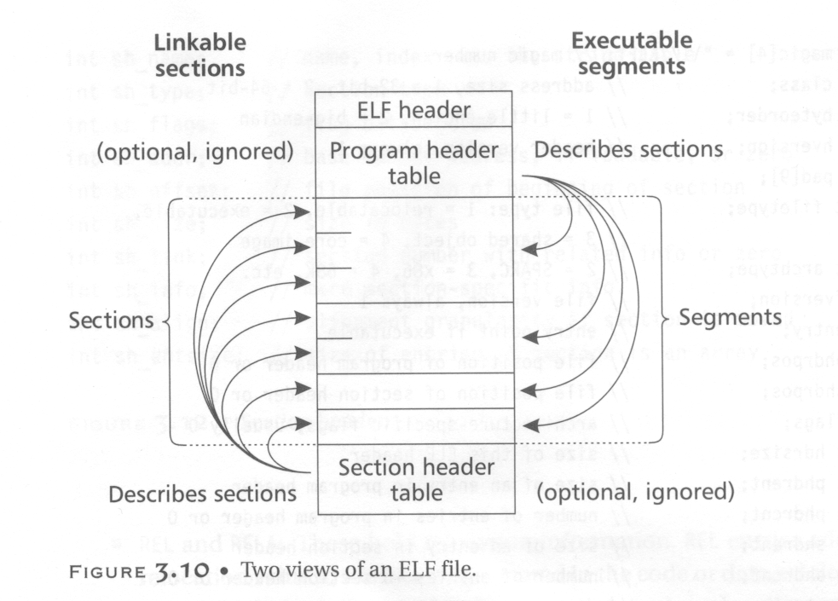
ELF Structure
segments

Slide 46
ELF Structure
A single segment usually consist of several sections. E.g., a loadable read-only segment could contain sections for executable code, read-only data, and symbols for the dynamic linker.
Relocatable files have section header tables. Executable files have program header tables. Shared object files have both.
Sections are intended for further processing by a linker, while the segments are intended to be mapped into memory.

Slide 47
ELF Header
The Elf header is always at offset zero of the file.
The program header table and the section header table’s offset in the file are defined in the ELF header.
The header is decodable even on machines with a different byte order from the file’s target architecture.
  After reading class and byteorder fields, the rest fields in the elf header can be decoded.
  The elf format can support two different address sizes:
    32 bits
    64 bits

Slide 48
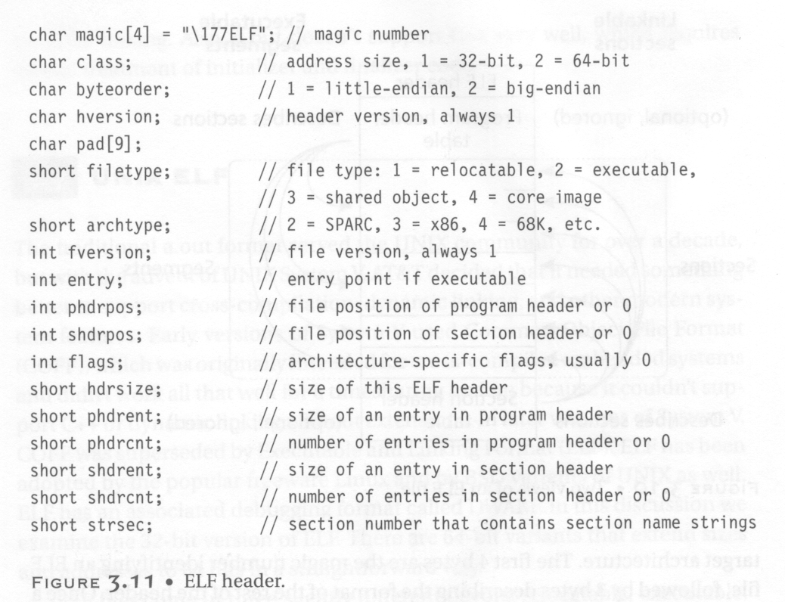

Slide 49
Relocatable Files
A relocatable or shared object file is a collection of sections.
Each section contains a single type of information, such as program code, read-only data,or read/write data, relocation entries,or symbols.
Every symbol’s address is defined relative to a section.
  Therefore, a procedure’s entry point is relative to the program code section that contains that procedure’s code.

Slide 50
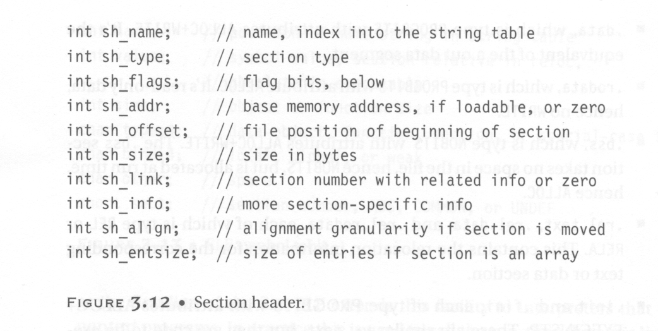
Section Header

Slide 51
Types in Section Header
PROGBITS: This holds program contents including code, data, and debugger information.
NOBITS: Like PROGBITS. However, it occupies no space.
SYMTAB and DYNSYM: These hold symbol table.
STRTAB: This is a string table, like the one used in a.out.
REL and RELA: These hold relocation information.
DYNAMIC and HASH: This holds information related to dynamic linking.

Slide 52
Flags in Section Header
WRITE: This section contains data that is writable during process execution.
ALLOC: This section occupies memory during process execution.
EXECINSTR: This section contains executable machine instructions.

Slide 53
Various Sections
.text:
  This section holds executable instructions of a program.
  Type: PROGBITS
  Flags: ALLOC + EXECINSTR
.data:
  This section holds initialized data that contributes to the program’s image.
  Type: PROGBITS
  Flags: ALLOC + WRITE

Slide 54
Various Sections
.rodata:
  This section holds read-only data.
  Type: PROGBITS
  Flags: ALLOC
.bss :
  This section holds uninitialized data that contributed to the program’s image. By definition, the system will initialize the data with zero when the program begins to run.
  Type: NOBITS
  Flags: ALLOC + WRITE

Slide 55
Various Sections
.rel.text, .rel.data, and .rel.rodata:
  These contain the relocation information for the corresponding text or data sections.
  Type: REL
  Flags: ALLOC is turned on if the file has a loadable segment that includes relocation.
.symtab:
  This section hold a symbol table.
.strtab:
  This section holds strings.

Slide 56
Various Sections
.init:
  This section holds executable instructions that contribute to the process initialization code.
  Type: PROGBITS
  Flags: ALLOC + EXECINSTR
.fini:
  This section hold executable instructions that contribute to the process termination code.
  Type: PROGBITS
  Flags: ALLOC + EXECINSTR
C does not need these two sections. However, C++ needs them.

Slide 57
Various Sections
.interp:
  This section holds the pathname of a program interpreter.
  Type: ALLOC
  Flags: PROGBITS
  If this section is present, rather than running the program directly, the system runs the interpreter and passes it the elf file as an argument.
  For many years (used in a.out), UNIX has had self-running interpreted text files, using
  #! /bin/csh as the first line of the file.
  Elf extends this facility to interpreters that run nontext programs.
  In practice, this is used to run the run-time dynamic linker to load the program and to link in any required shared libraries.

Slide 58
Various Sections
.debug:
  This section holds symbolic debugging information.
  Type: PROGBIT
.line:
  This section holds line number information for symbolic debugging, which describes the correspondence between the program source and the machine code (ever used gdb?)
  Type: PROGBIT
.comment
  This section may store extra information.

Slide 59
Various Sections
.got:
  This section holds the global offset table.
    We will explain got when we present shared library.
  Type: PROGBIT
.plt:
  This section holds the procedure linkage table.
  Type: PROGBIT
.note:
  This section contains some extra information.

Slide 60
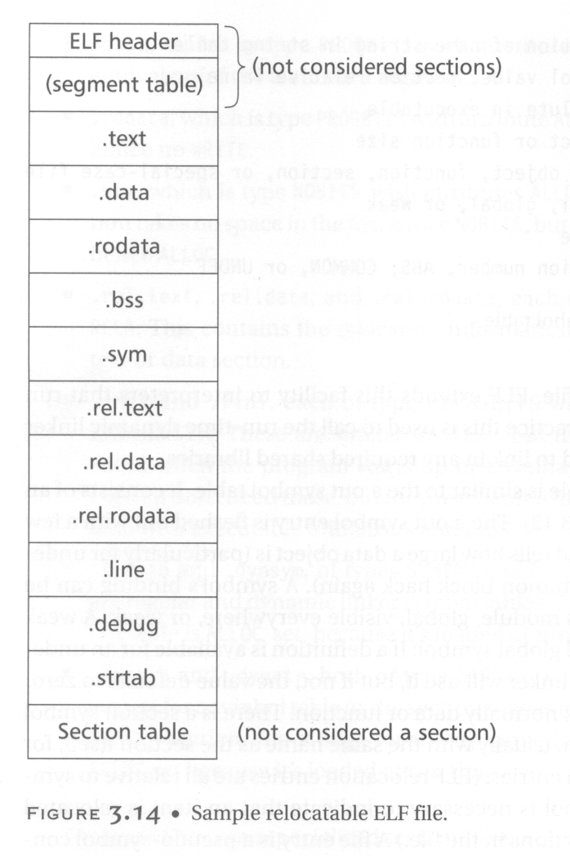
A typical relocatable file.

Slide 61
String Table
Like the format used in a.out.
String table sections hold null-terminated character sequences, commonly called strings.
The object file uses these strings to represent symbol and section names.
We use an index into the string table section to reference a string.
The reason why we separate symbol names from symbol tables is that in C or C++, there is no limitation on the length of a symbol.

Slide 62
Symbol Table
An object file’s symbol table holds information needed to locate and relocate a program’s symbolic definition and references.
A symbol table index is a subscript into this array.

Slide 63
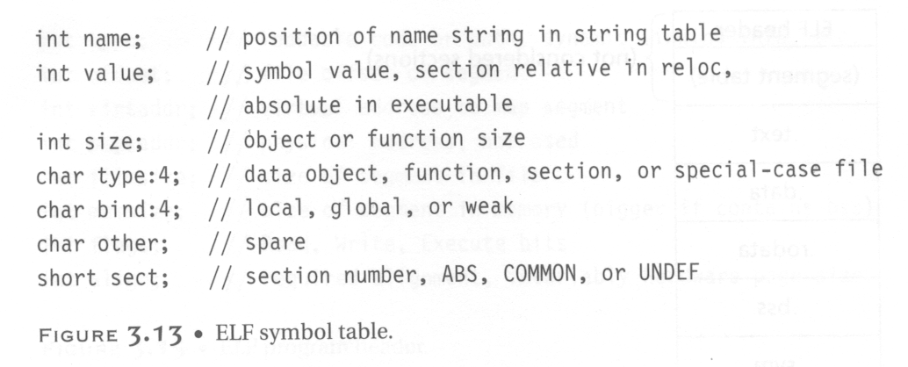
Symbol Table
e.g., int, double
If a definition is available
for an undefined weak
symbol, the linker will use
it. Otherwise, the value
defaults to 0.
The section relative to which the symbol
is defined. (e.g., the function entry points
are defined relative to .text)

Slide 64
Relocation Table
Relocation is the process of connecting symbolic references with symbolic definitions.
Relocatable files must have information that describes how to modify their section contents.
A relocation table consists on many relocation structures.

Slide 65
Relocation Structure
Struct {
  R_offset;
  This field gives the location at which to apply the relocation.
  For a relocatable file, the value is the byte offset from the beginning of the section to the storage unit affect by the relocation.
  For an executable file and shared object, the value is the virtual address of the storage unit affected by the relocation.

Slide 66
Relocation Structure
  R_info;
  This field gives both the symbol table index with respect to which the relocation must be made and the type of relocation to apply.
  R_addend;
  This field specifies a constant addend used to compute the value to be stored into the relocation field.
}

Slide 67
Executable Files
An executable file usually has only a few segments. E.g.,
  A read-only one for the code.
  A read-only one for read-only data.
  A read/write one for read/write data.
All of the loadable sections are packed into the appropriate segments so that the system can map the file with just one or two operations.
  E.g., If there is a .init and .fini sections, those sections will be put into the read-only text segment.

Slide 68
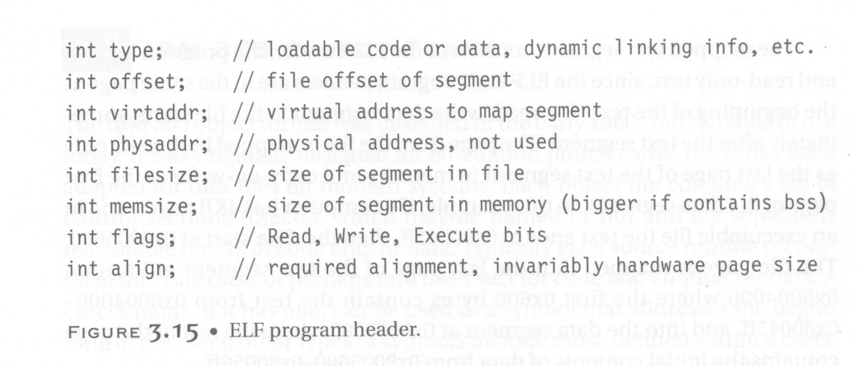
Program Header

Slide 69
The Types in Program Header
This field tells what kind of segment this array element describes:
  PT_LOAD: This segment is a loadable segment.
  PT_DYNAMIC: This array element specifies dynamic linking information.
  PT_INTERP: This element specified the location and size of a null-terminated path name to invoke as an interpreter.

Slide 70
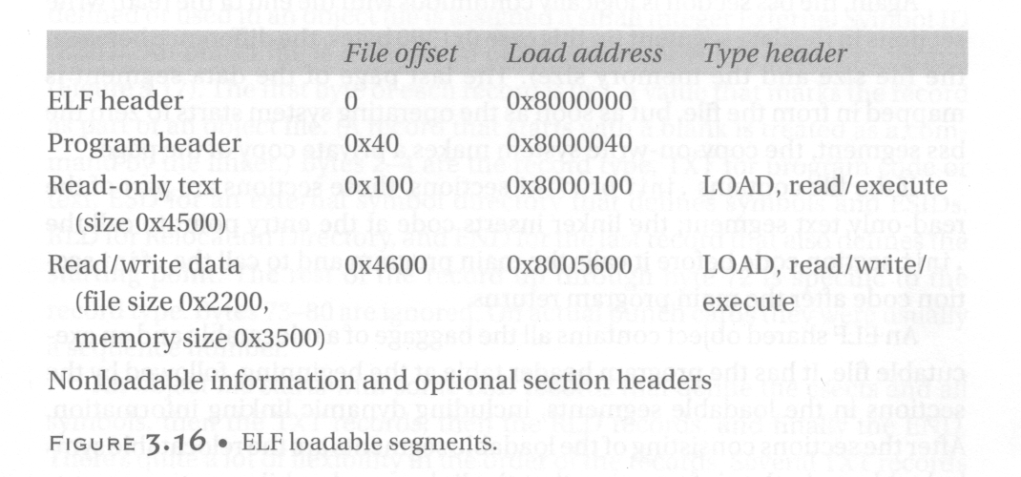
Executable File Example

Slide 71
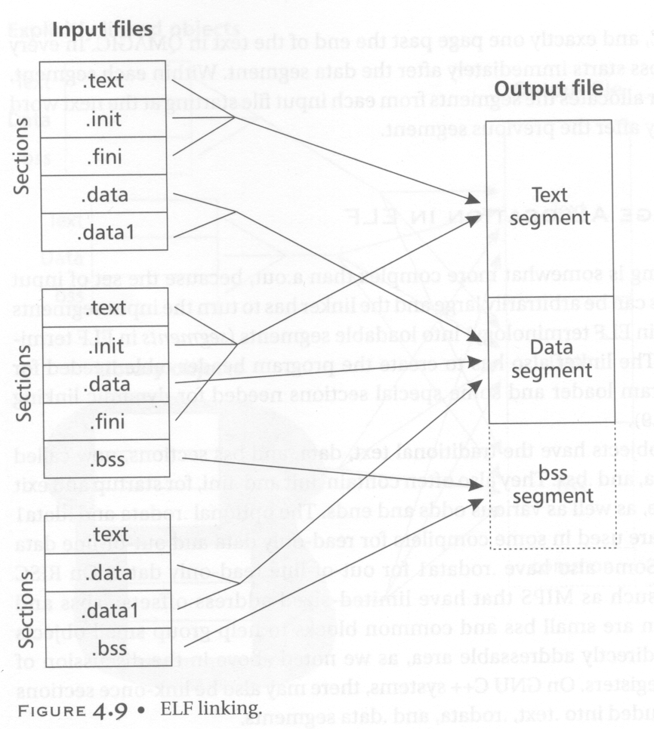
Elf Linking

Slide 72
Elf File Trace
(We can use the objdump or nm command)

Slide 73
Program Header
Program Header:
PHDR off 0x00000034 vaddr 0x08048034 paddr 0x08048034 align 2**2
filesz 0x000000c0 memsz 0x000000c0 flags r-x
INTERP off 0x000000f4 vaddr 0x080480f4 paddr 0x080480f4 align 2**0
filesz 0x00000019 memsz 0x00000019 flags r--
LOAD off 0x00000000 vaddr 0x08048000 paddr 0x08048000 align 2**12
filesz 0x00000564 memsz 0x00000564 flags r-x
LOAD off 0x00000564 vaddr 0x08049564 paddr 0x08049564 align 2**12
filesz 0x000000a8 memsz 0x000000cc flags rw-
DYNAMIC off 0x0000059c vaddr 0x0804959c paddr 0x0804959c align 2**2
filesz 0x00000070 memsz 0x00000070 flags rw-
NOTE off 0x00000110 vaddr 0x08048110 paddr 0x08048110 align 2**2
filesz 0x00000018 memsz 0x00000018 flags r--

Slide 74
Dynamic Section
Dynamic Section:
NEEDED libc.so.4
INIT 0x8048390
FINI 0x8048550
HASH 0x8048128
STRTAB 0x80482c8
SYMTAB 0x80481b8
STRSZ 0xad
SYMENT 0x10
DEBUG 0x0
PLTGOT 0x8049584
PLTRELSZ 0x18
PLTREL 0x11
JMPREL 0x8048378
Need to link this shared library
for printf()

Slide 75
Section Header
Sections:
Idx Name Size VMA LMA File off Algn
0 .interp 00000019 080480f4 080480f4 000000f4 2**0
CONTENTS, ALLOC, LOAD, READONLY, DATA
1 .note.ABI-tag 00000018 08048110 08048110 00000110 2**2
CONTENTS, ALLOC, LOAD, READONLY, DATA
2 .hash 00000090 08048128 08048128 00000128 2**2
CONTENTS, ALLOC, LOAD, READONLY, DATA
3 .dynsym 00000110 080481b8 080481b8 000001b8 2**2
CONTENTS, ALLOC, LOAD, READONLY, DATA
4 .dynstr 000000ad 080482c8 080482c8 000002c8 2**0
CONTENTS, ALLOC, LOAD, READONLY, DATA
5 .rel.plt 00000018 08048378 08048378 00000378 2**2
CONTENTS, ALLOC, LOAD, READONLY, DATA
6 .init 0000000b 08048390 08048390 00000390 2**2
CONTENTS, ALLOC, LOAD, READONLY, CODE
7 .plt 00000040 0804839c 0804839c 0000039c 2**2
CONTENTS, ALLOC, LOAD, READONLY, CODE
8 .text 00000174 080483dc 080483dc 000003dc 2**2 CONTENTS, ALLOC, LOAD, READONLY, CODE

Slide 76
Section Header (cont’d)
9 .fini 00000006 08048550 08048550 00000550 2**2
CONTENTS, ALLOC, LOAD, READONLY, CODE
10 .rodata 0000000e 08048556 08048556 00000556 2**0
CONTENTS, ALLOC, LOAD, READONLY, DATA
11 .data 0000000c 08049564 08049564 00000564 2**2
CONTENTS, ALLOC, LOAD, DATA
12 .eh_frame 00000004 08049570 08049570 00000570 2**2
CONTENTS, ALLOC, LOAD, DATA
13 .ctors 00000008 08049574 08049574 00000574 2**2
CONTENTS, ALLOC, LOAD, DATA
14 .dtors 00000008 0804957c 0804957c 0000057c 2**2
CONTENTS, ALLOC, LOAD, DATA
15 .got 00000018 08049584 08049584 00000584 2**2
CONTENTS, ALLOC, LOAD, DATA
16 .dynamic 00000070 0804959c 0804959c 0000059c 2**2
CONTENTS, ALLOC, LOAD, DATA
17 .bss 00000024 0804960c 0804960c 0000060c 2**2
ALLOC
18 .stab 000001bc 00000000 00000000 0000060c 2**2
CONTENTS, READONLY, DEBUGGING
19 .stabstr 00000388 00000000 00000000 000007c8 2**0
CONTENTS, READONLY, DEBUGGING
20 .comment 000000c8 00000000 00000000 00000b50 2**0

Slide 77
Symbol Table
SYMBOL TABLE:
080480f4 l d .interp 00000000
08048110 l d .note.ABI-tag 00000000
08048128 l d .hash 00000000
080481b8 l d .dynsym 00000000
080482c8 l d .dynstr 00000000
08048378 l d .rel.plt 00000000
08048390 l d .init 00000000
0804839c l d .plt 00000000
080483dc l d .text 00000000
08048550 l d .fini 00000000
08048556 l d .rodata 00000000
08049564 l d .data 00000000
08049570 l d .eh_frame 00000000
08049574 l d .ctors 00000000
0804957c l d .dtors 00000000
08049584 l d .got 00000000
0804959c l d .dynamic 00000000

Slide 78
Symbol Table (cont’d)
0804960c l d .bss 00000000
00000000 l d .stab 00000000
00000000 l d .stabstr 00000000
00000000 l d .comment 00000000
00000000 l d .note 00000000
00000000 l d *ABS* 00000000
00000000 l d *ABS* 00000000
00000000 l d *ABS* 00000000
00000000 l df *ABS* 00000000 crtstuff.c
08048460 l .text 00000000 gcc2_compiled.
08049568 l O .data 00000000 p.3
0804957c l O .dtors 00000000 __DTOR_LIST__
0804956c l O .data 00000000 completed.4
08048460 l F .text 00000000 __do_global_dtors_aux
08049570 l O .eh_frame 00000000 __EH_FRAME_BEGIN__

Slide 79
Symbol Table (cont’d)
080484b4 l F .text 00000000 fini_dummy
0804960c l O .bss 00000018 object.11
080484bc l F .text 00000000 frame_dummy
080484e0 l F .text 00000000 init_dummy
08049570 l O .data 00000000 force_to_data
08049574 l O .ctors 00000000 __CTOR_LIST__
00000000 l df *ABS* 00000000 crtstuff.c
08048520 l .text 00000000 gcc2_compiled.
08048520 l F .text 00000000 __do_global_ctors_aux
08049578 l O .ctors 00000000 __CTOR_END__
08048548 l F .text 00000000 init_dummy
08049570 l O .data 00000000 force_to_data
08049580 l O .dtors 00000000 __DTOR_END__
08049570 l O .eh_frame 00000000 __FRAME_END__
00000000 l df *ABS* 00000000 p10.c
080483ac F *UND* 00000031 printf
0804959c g O *ABS* 00000000 _DYNAMIC
08048550 g O *ABS* 00000000 _etext
08048390 g F .init 00000000 _init
08049624 g O .bss 00000004 environ
00000000 w *UND* 00000000 __deregister_frame_info
08049630 g O *ABS* 00000000 end
08049628 g O .bss 00000004 xx

Slide 80
Symbol Table (cont’d)
08049564 g O .data 00000004 __progname
080483dc g F .text 00000083 _start
0804960c g O *ABS* 00000000 __bss_start
080484e8 g F .text 00000038 main
08048550 g F .fini 00000000 _fini
0804962c g O .bss 00000004 yy
080483bc F *UND* 00000070 atexit
0804960c g O *ABS* 00000000 _edata
08049584 g O *ABS* 00000000 _GLOBAL_OFFSET_TABLE_
08049630 g O *ABS* 00000000 _end
080483cc F *UND* 0000005b exit
00000000 w *UND* 00000000 __register_frame_info

Slide 81
Dynamic Symbol Table
DYNAMIC SYMBOL TABLE:
080483ac DF *UND* 00000031 printf
0804959c g DO *ABS* 00000000 _DYNAMIC
08048550 g DO *ABS* 00000000 _etext
08048390 g DF .init 00000000 _init
08049624 g DO .bss 00000004 environ
00000000 w D *UND* 00000000 __deregister_frame_info
08049630 g DO *ABS* 00000000 end
08049564 g DO .data 00000004 __progname
0804960c g DO *ABS* 00000000 __bss_start
08048550 g DF .fini 00000000 _fini
080483bc DF *UND* 00000070 atexit
0804960c g DO *ABS* 00000000 _edata
08049584 g DO *ABS* 00000000 _GLOBAL_OFFSET_TABLE_
08049630 g DO *ABS* 00000000 _end
080483cc DF *UND* 0000005b exit
00000000 w D *UND* 00000000 __register_frame_info

Slide 82
Dynamic Relocation Table
DYNAMIC RELOCATION RECORDS
OFFSET TYPE VALUE
08049590 R_386_JUMP_SLOT printf
08049594 R_386_JUMP_SLOT atexit
08049598 R_386_JUMP_SLOT exit

Slide 83
Library
Library is a collection of resources used to develop software.
These may include pre-written code and subroutines, classes, values or type specifications.
Libraries contain code and data that provide services to independent programs.
Adv- sharing and changing of code and data in a modular fashion, and eases the distribution of the code and data.
Some executables are both standalone programs and libraries, but most libraries are not executable. Executables and libraries make references known as links to each other through the process known as linking, which is typically done by a linker.

Slide 84
Shared Libraries
shared library or shared object is a file that is intended to be shared by executable files and further shared objects files.
Modules used by a program are loaded from individual shared objects into memory at load time or run time, rather than being copied by a linker when it creates a single monolithic executable file for the program.

Slide 85
Shared Libraries
Shared libraries remove the common library routines from the executable file
Maintaining a single copy of the library routine somewhere in memory that all processes reference.
This reduces the size of each executable file (But may add some runtime overhead,either when the program is first executed or the first time each shared library function is called)
Another advantage of shared libraries is that library functions can be replaced with new versions without having to relink edit every program that uses the library.

Slide 86
$ cc -static hello1.c prevent gcc from using shared libraries
$ ls -l a.out
-rwxrwxr-x 1 sar 475570 Feb 18 23:17 a.out
$ size a.out
text data bss dec hex filename
375657 3780 3220 382657 5d6c1 a.out
If we compile this program to use shared libraries, the text and data sizes of the executable file are greatly decreased:
$ cc hello1.c gcc defaults to use shared libraries
$ ls -l a.out
-rwxrwxr-x 1 sar 11410 Feb 18 23:19 a.out
$ size a.out
text data bss dec hex filename
872 256 4 1132 46c a.out

Slide 87
http://tldp.org/HOWTO/Program-Library-HOWTO/shared-libraries.html

